Slide 1
Human resources slide 1
HUMAN RESOURCES
Your Employees Are Your Assets
By : Group 1
Prarthana Puranik
Raj Panjwani
Nitin Thakkar

Slide 2
Human resources slide 2
AGENDA
Business Idea
Our Solution
Target Operating Model
Our Team

Slide 3
Human resources slide 4
CHALLENGES FOR HUMAN RESOURCES DEPARTMENT
INTERVIEWS & RECRUITMENT
EMPLOYEE ATTRITION
ATTRACTING TALENT FOR THE ENTERPRISE
BALANCING CULTURE
HUMAN RESOURCES
Notes:
What are some of the challenges any HR dept faces.
Read all the bubbles
Out of all these, we would like to address the Employee attrition today

Slide 4

Human resources slide 3
EMPLOYEES DISTRIBUTION
Gender Ratio:
Male and Female ratio is 60% and 40% respectively
Departments:
Human Resources -63
Research & Development-961
Sales-446
84%
Distance to Home:
75% of employees are within 15 miles of the workplace
Job Levels:
1-543
2-1068
3-654
4-424
5-345
Employees Stay with
Company
Hourly Rate:
More than 50% of the employees are paid hourly rate above $60
Education:
Doctor-240
Master-1592
Bachelor-1716
College-564
Below College-170
Total Working Years:
Records of 1462 employees
Around 50% of the employees have 0-10 years of working period whereas other 50% have 10-40 years total working period
Notes:
We took one company’s data to create our web application considering any big tech organization would have similar volume of employees and almost similar distribution of employess over various departments and job levels
Talking about the general stats of this data: Read the slide data
There are several factors behind why trained and experienced employees leave the company and the company loses its asset.
The cost of rehiring includes interviewing for multiple rounds, and it happens sometimes that a shortlisted person does not join after spending all the time and money for interview, and it starts from square one.
So, if there is a system which can predict and inform HR that which employee is likely to leave the company, HR and the management can take steps to retain the employee by possibly fulfilling employee’s expectations.
Here we have designed an App which will present variety of data to the HR and help them to find out which employee is likely to leave the company.

Slide 5

Human resources slide 5
Acquire Past Data and store to Azure DB- MySQL
About Our WebApp
Use Forms to Enter Singular Data from the WebApp
View Google Charts for Specific Information
Get Specific Data using APIs
Notes:
Our Web Application serves these four important steps:
It acquires the past data from the customer and stores it onto cloud database
Using forms for singular data entry
User can view analytics in form of google charts
You can get specific or all data you need for any record

Slide 6
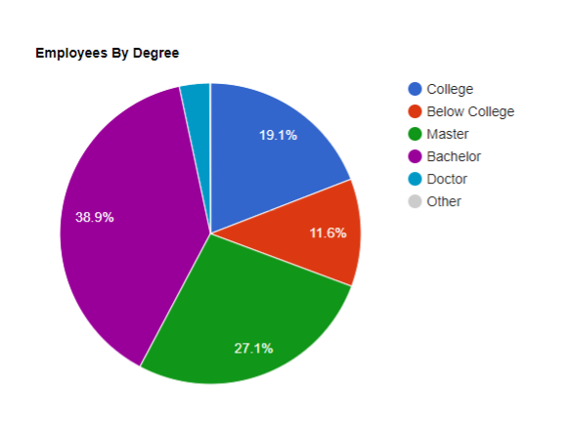
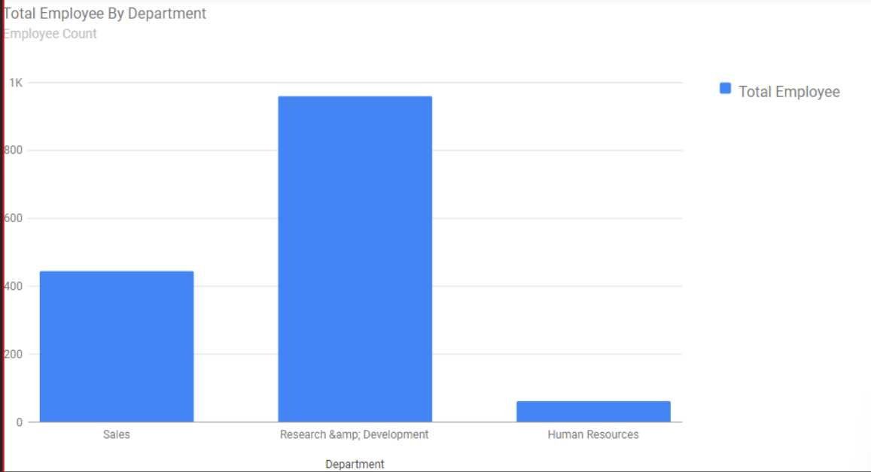
Human resources slide 7
Features on our WebApp and Charts
Notes:
As it is shown on the top of this slide, there are different pages, like Home page, add data, view data, Analysis i.e. displaying charts, and about us
And charts show how the charts on webApp will look like.

Slide 7

Human resources slide 7
It’s Demo Time …
45%
10%
35%
10%
Notes:
Now let’s take you to the demo.

Slide 8

Human resources slide 8
Fit Gap Analysis
We have used one time data fetch from the URL, batch process every 24 hours to scrap data from the customer’s URL is to be implemented.

Slide 9
Human resources slide 6
What Can a Complete Product Look Like:
Predictor System using Advance Machine learning can be added, so that the WebApp provides prediction about next leaving employee
More features can be added to this WebApp to address other HR challenges
Charts and dashboards can be made more interactive and with more selection options
Notes:
Currently, we are showing the data analytics as machine learning prediction was not in scope of this POC, but for end customer product prediction algorithm can be implemented

Slide 10



Human resources slide 9
Meet The Team
Nitin:
Hi, I am a Project manager of this team. I have close to 6 years of professional work experience as a Data Engineer. Love to work with my team and boost their motivation.
Raj:
Hi there! I am Raj, I recently graduated in IT, and I have immense love for data analytics and python.
Prarthana:
Hello, My role in this team is a business analyst. I have 9+ years of embedded development experience in Automotive industry. My motto is bridging the gap between business and IT.
Nitin Thakkar
Raj
Panjwani
Prarthana
Puranik

Slide 11
Human resources slide 10
Thank You

